Slide 1

The Enterprise Clown
Builds SharePoint apps with Node.js
Notes:
This is his first public appearance, possibly his last?

Slide 2
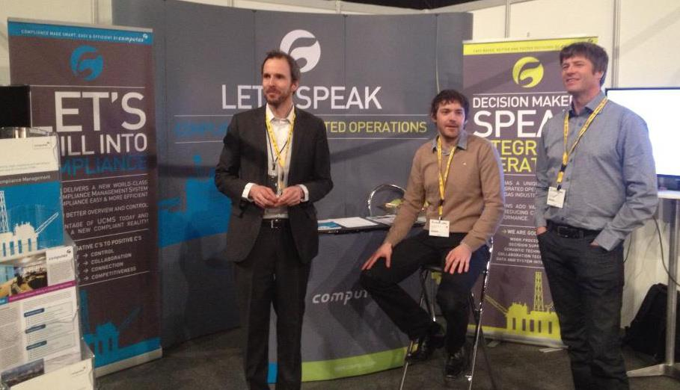
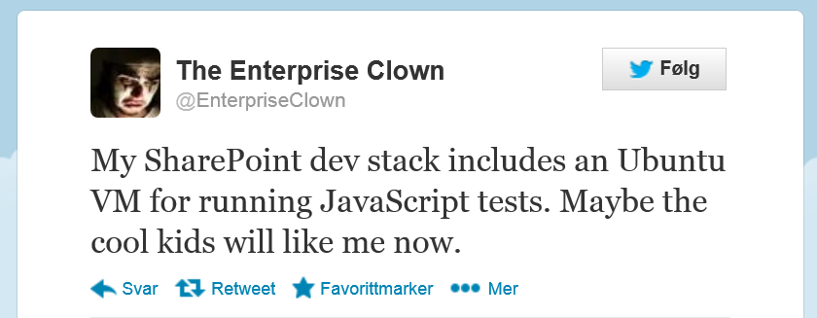
Who are we
Notes:
Hi. I am @TheEnterpriseClown and @bjartnes. @bjartnes is a SharePoint Developer at Computas. @TheEnterpriseClown is the alter ego of @bjartnes. When @bjartnes starts up Visual Studio 2012 and TFS, his alter ego is fed with rage, screaming for VIM and git. When @bjartnes carries his huge 32 GB RAM 2 spinning disks SharePoint dev environment around to the next scrum demo, almost breaking his back, you'll find @TheEnterpriseClown wants to go to a cool cafe at Tøyen to hack away on his ultrabook.
I'm not making fun of personality disorders here. I'm just struggling myself between trying way to hard to be a cool hacker with a linux ultrabook and the fact that I make my money building SharePoint applications for the Enterprise. Being laughed at in all camps
@bjartnes, works at Computas
@TheEnterpriseClown, messes with @bjartnes all day

Slide 3
Too cool to be Enterprise
Too Enterprisye to be cool
Notes:
A fool in both camps. This is where I am stuck.
I wear the mask of the clown for you to see my inner suffering

Slide 4
SharePoint vs node.js
Enterprisy monolithic product
IDE Driven Development assisted by wizards
Hipster factor: near zero
Lean
Functionality in modules
NPM
You choose dev. env.
Hipster factor: Almost Erlang and Clojure
Notes:
Didn’t even bother putting in header
Clash of cultures.
Why?

Slide 5
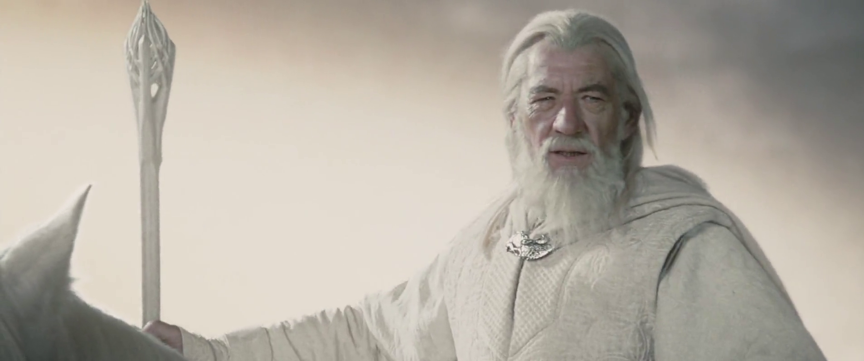
Notes:
Good Wizard

Slide 6
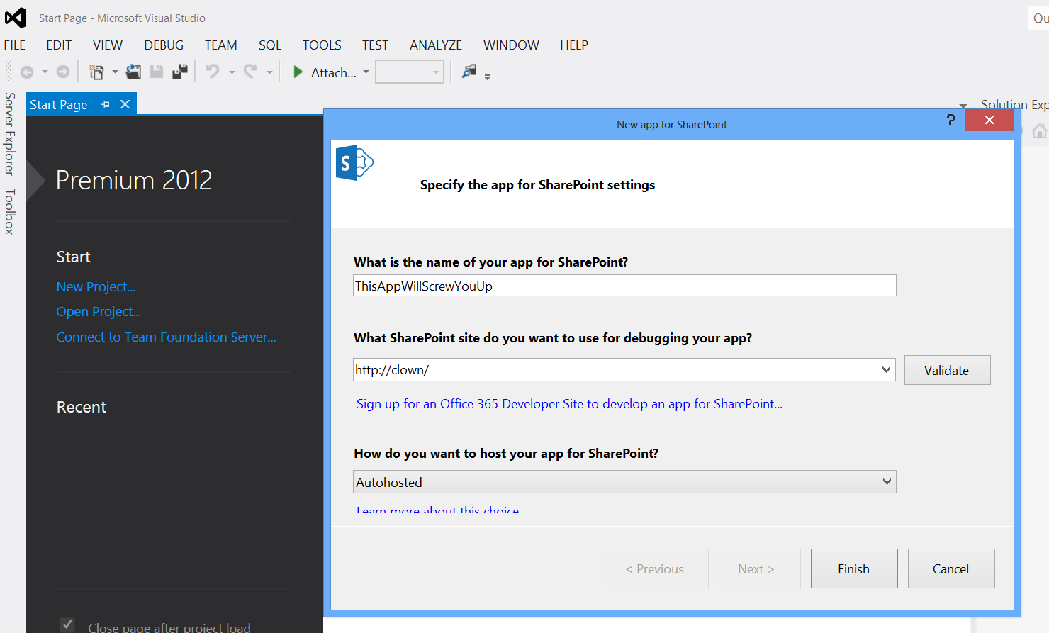
Notes:
Evil wizard
Blurring your eyes
You can no see or undertand what happens
TAKE THE RED PILL
Or, in case of SharePoint and Node.js > Eat both pills

Slide 7
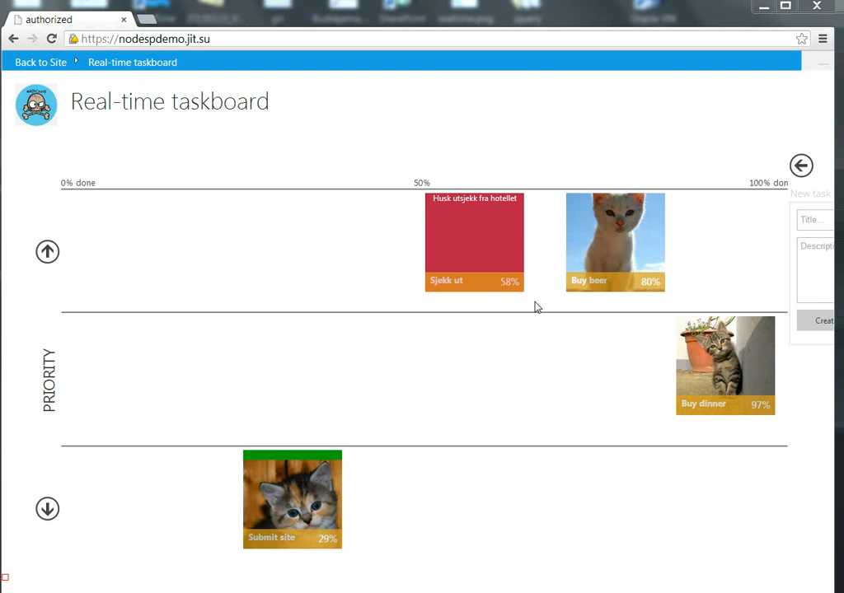
Notes:
http://www.youtube.com/watch?v=IqSecS5oGj4

Slide 8
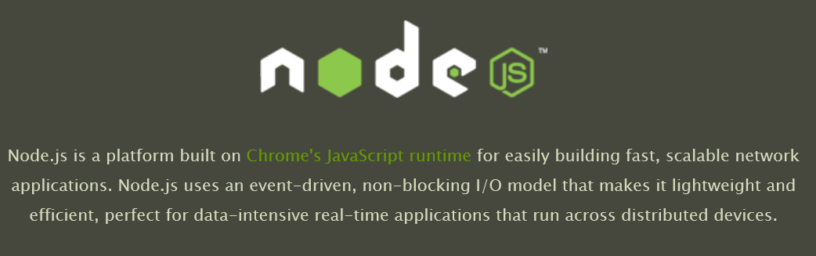
Notes:
This is really what a SharePoint App often is.
Distributed -> Runs in the cloud (SharePoint server, the client, ACS and third party services used)

Slide 9
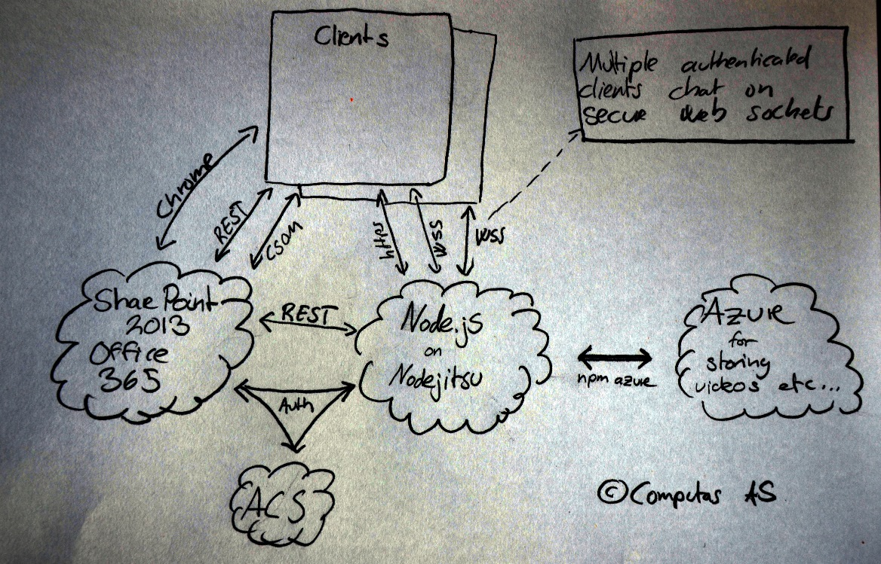
Notes:
This would look the same if you build other kinds of apps as well.
Enterprise clow is happy at this pointn
Can work with Linux of Mac, deploy using shell tools to cloud providers that specialize on Node.js hosting

Slide 10
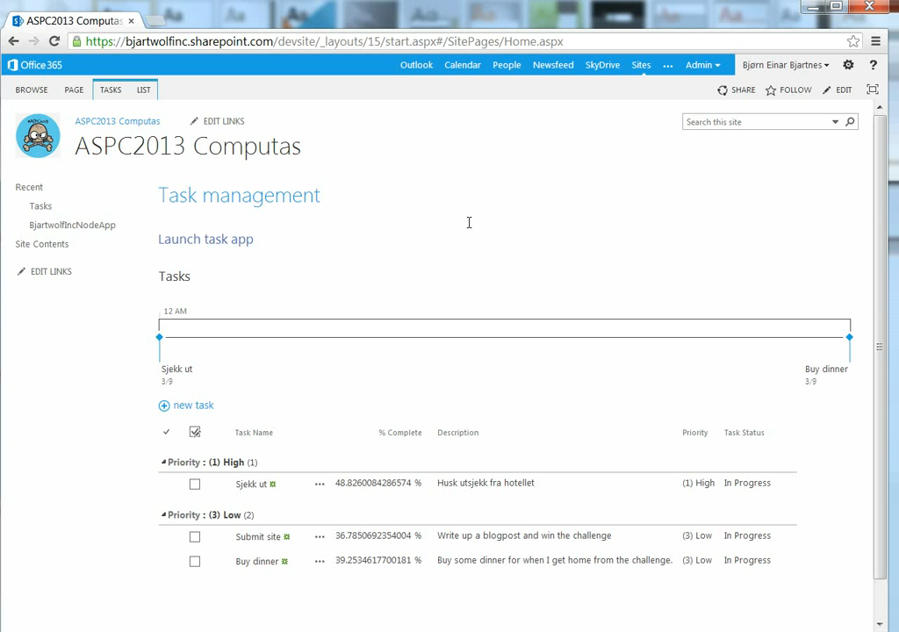

Slide 11
Results
Lightweight
Cheap to host and scale
Understandable
No automagic
Leverage modules
npm
*nix processes
Professional support

Slide 12
«Dare to wear the foolish clown face»
Frank Sinatra
Notes:
There are good reasons to not do as you are told
There are good reasons to dare to be the clown
Ignore the ignorant masses of the Enterprise
The clown declares victory
Clown – Enterprise
1 – 0

Slide 13
QuePort
@askildt, @jornare
The SharePoint App Wizardry for pissing me sufficiently off

